Slide 1
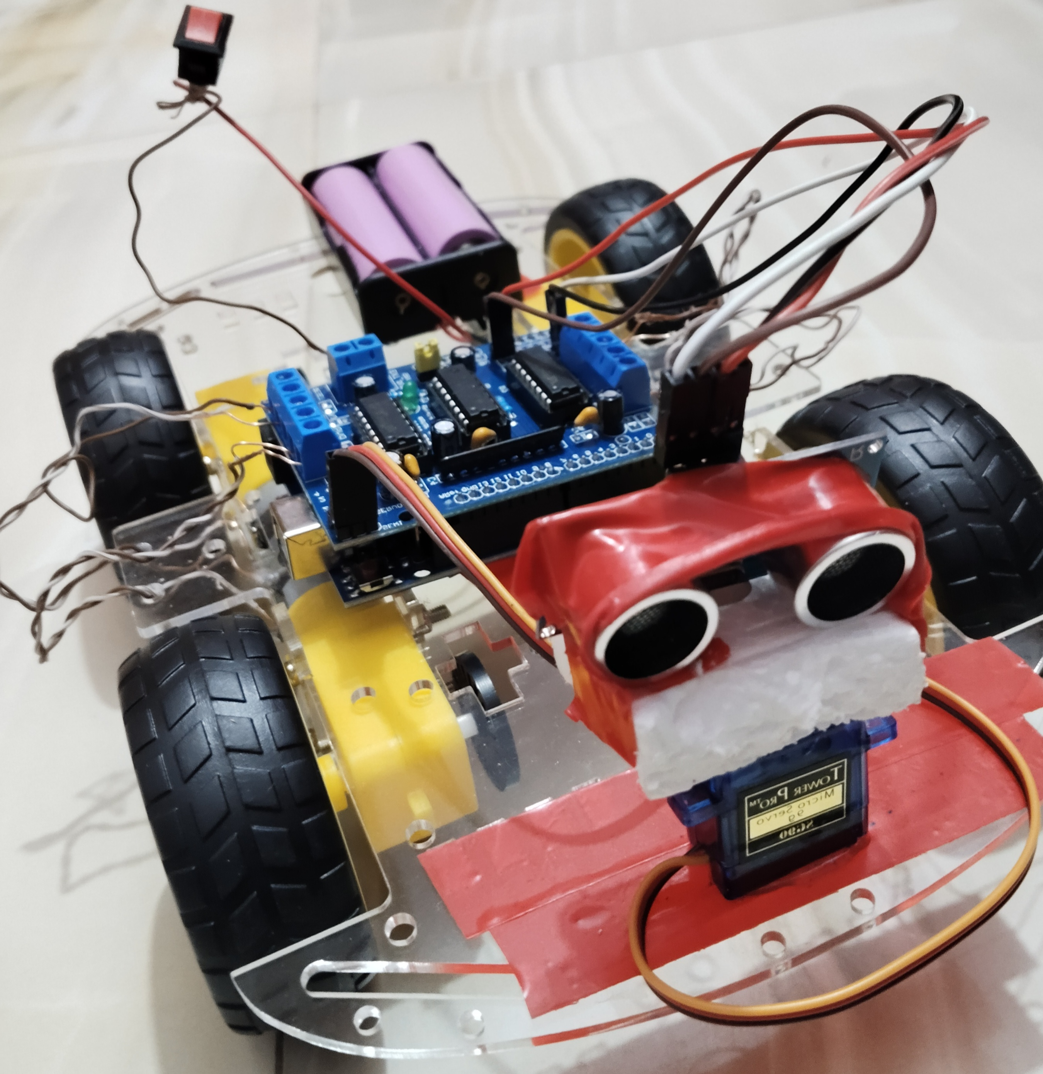
OBSTACLE AVOIDING ROBOT USING ARDUINO
y

Slide 2
Submitted to:
Mrs. Taniya Sultana
Lecturer
Department of CSE.
Course Code: CSE 2324
Course Title: Digital Logic Design
Submitted by:​
​
Tahasina Tasnim Afra (C233456)​
Maimuna Tabassum (C233460)​
Sadia Zannat (C233443)​
Tasmia Tabassum Kotha (C233461)​
Shakila Jahan Saima (C233442)
Submission on :
22th December 2024

Slide 3
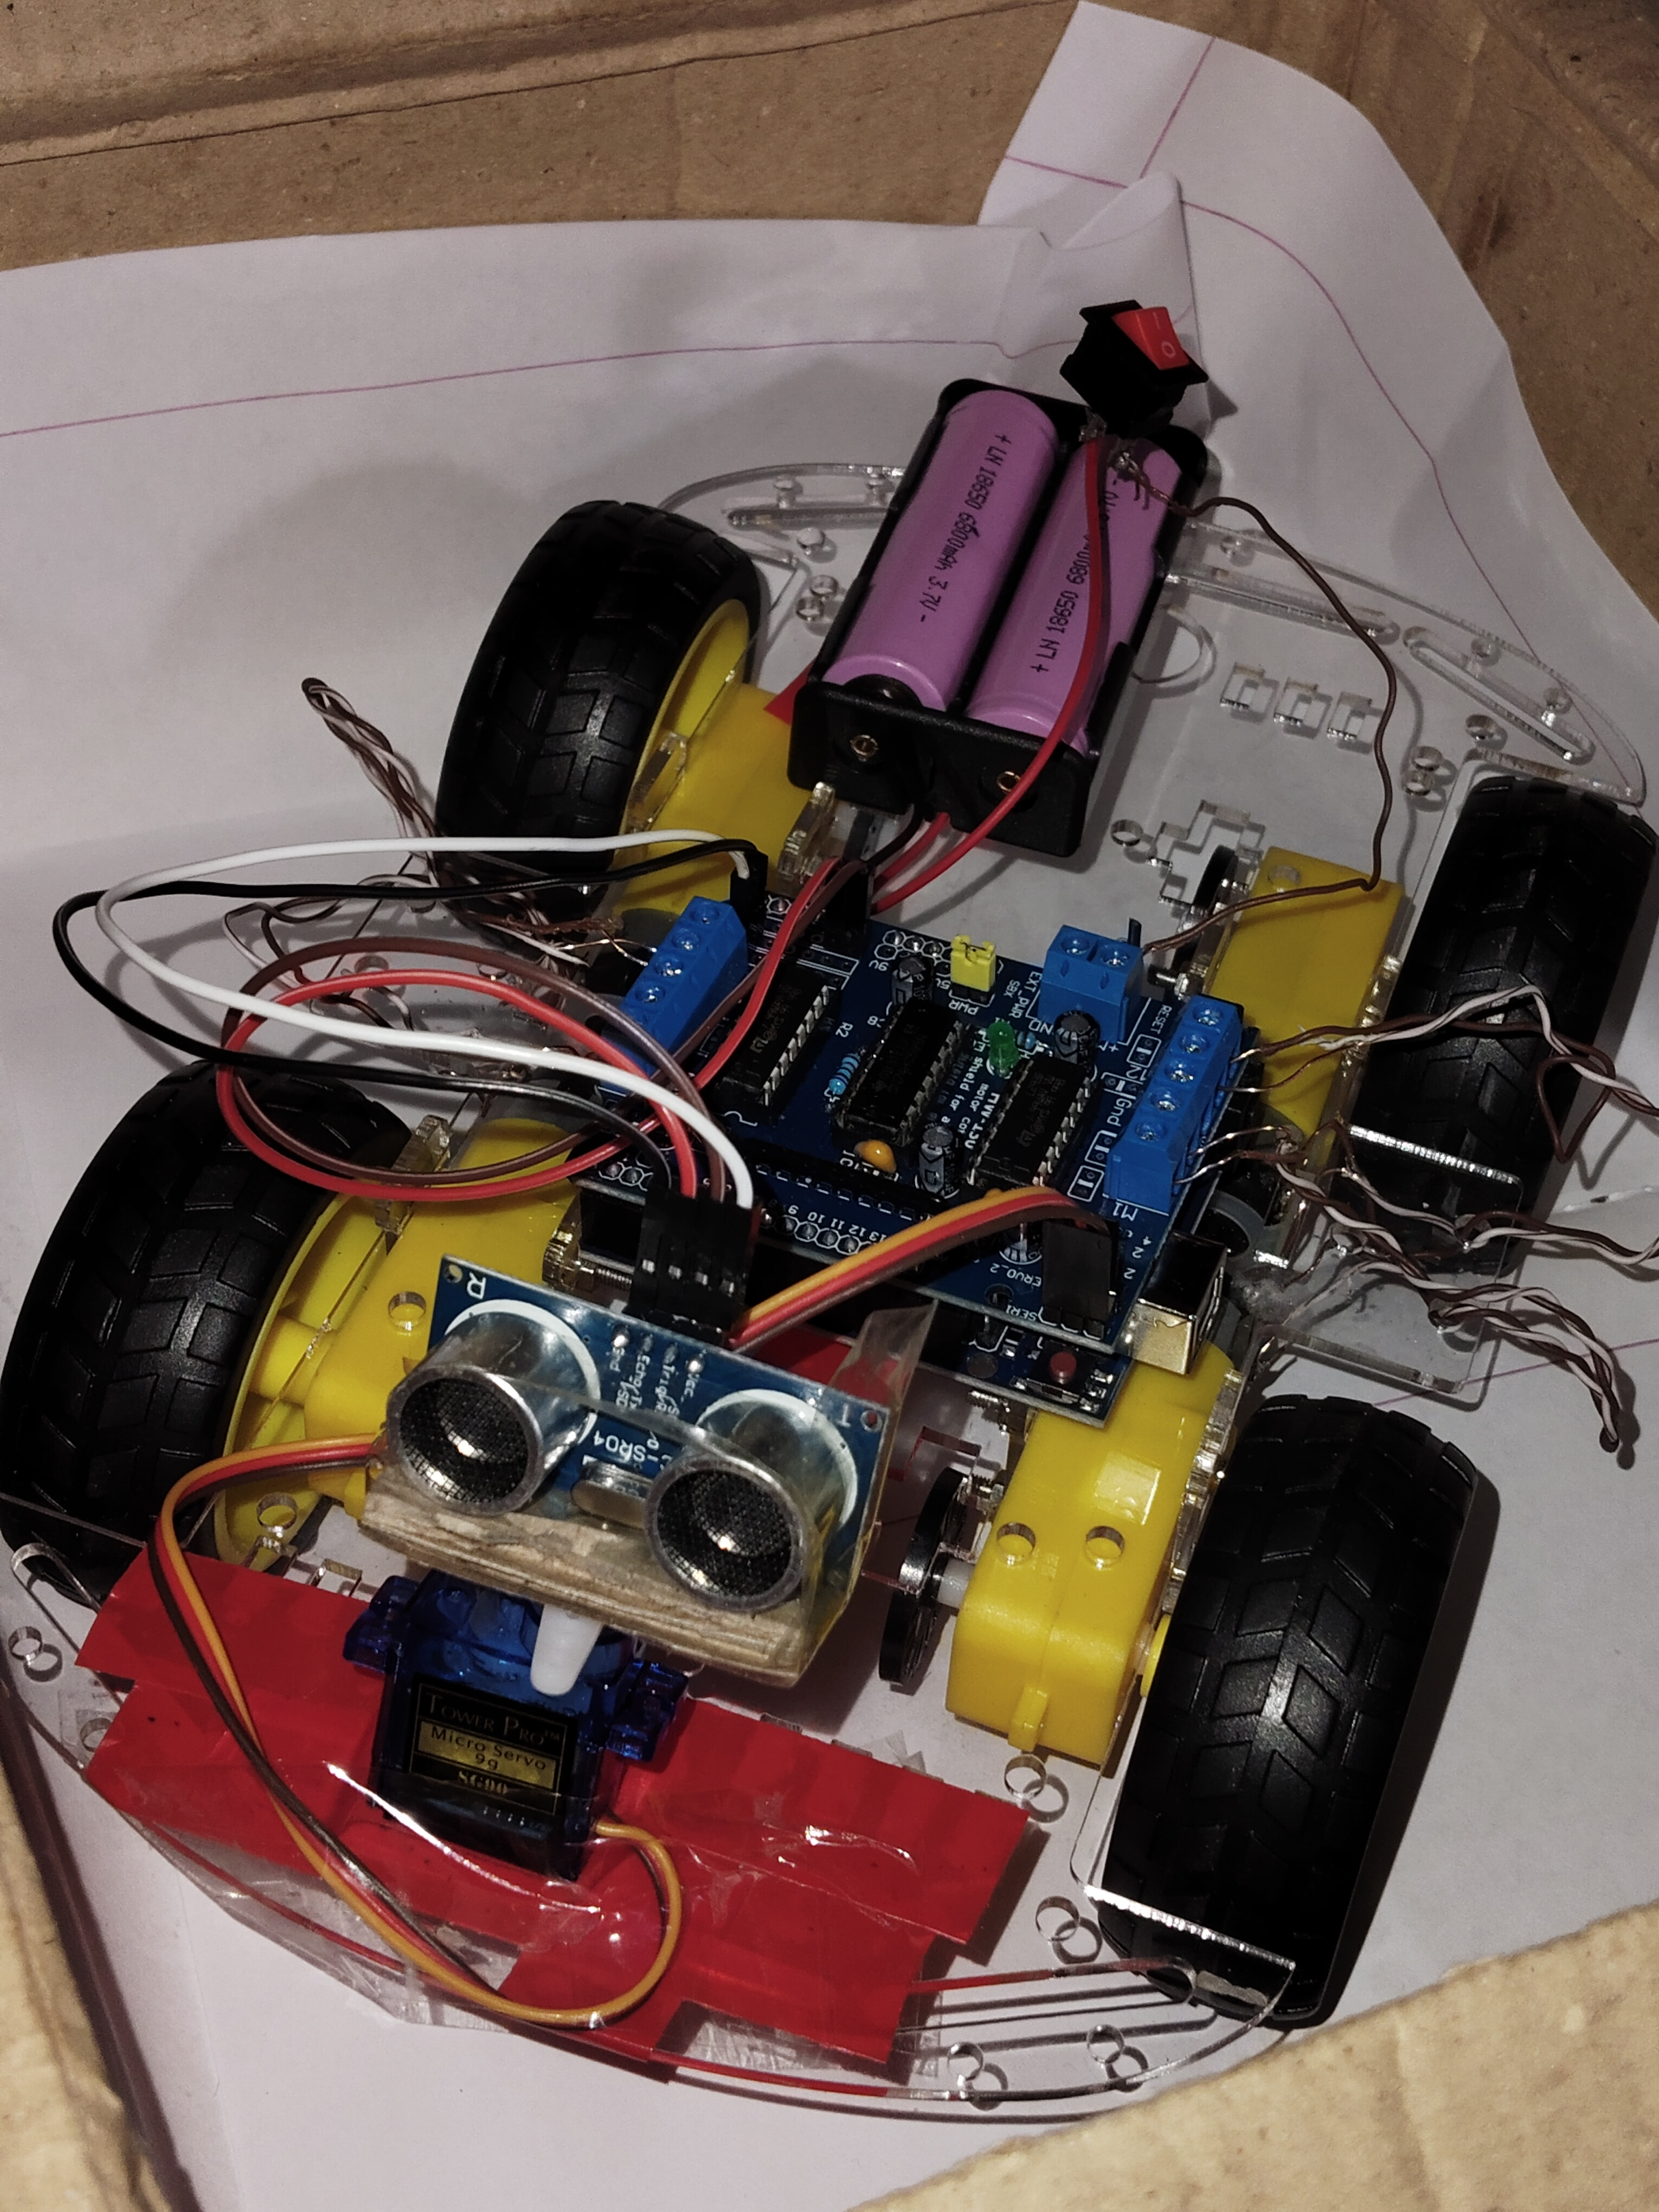
Abstract:
The project, "Obstacle Avoiding Robot Using Arduino," focuses on creating an autonomous robot capable of detecting and avoiding obstacles in its path. The robot utilizes sensors and an Arduino microcontroller to navigate environments efficiently. This report details the design, development, and implementation of the project, along with challenges encountered and solutions devised.
Introduction:
Obstacle avoidance is an essential feature for autonomous robotic systems, allowing them to operate safely in dynamic environments. This project integrates Arduino with sensors to achieve real-time obstacle detection and navigation..

Slide 4
g
Objectives:
To design a robot that is capable of detecting obstacles using sensors.
To understand the integration of software and hardware elements in robotics.
To implement a system for autonomous navigation using Arduino.

Slide 5
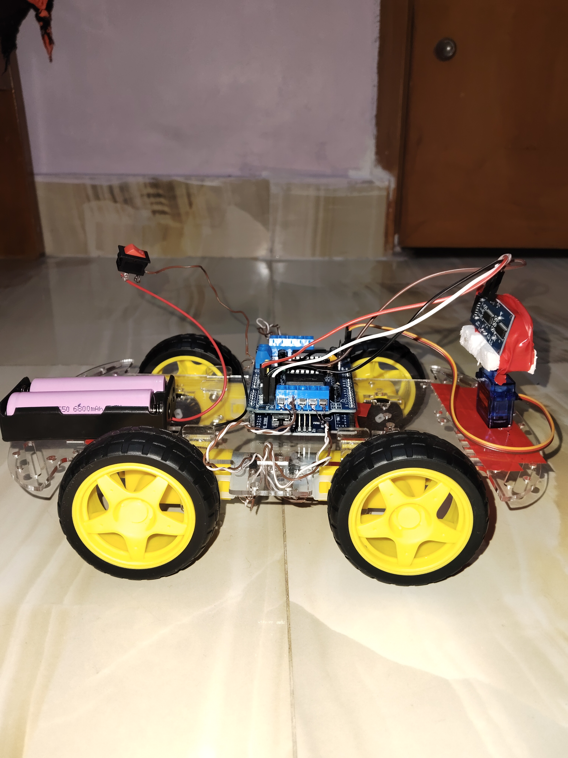

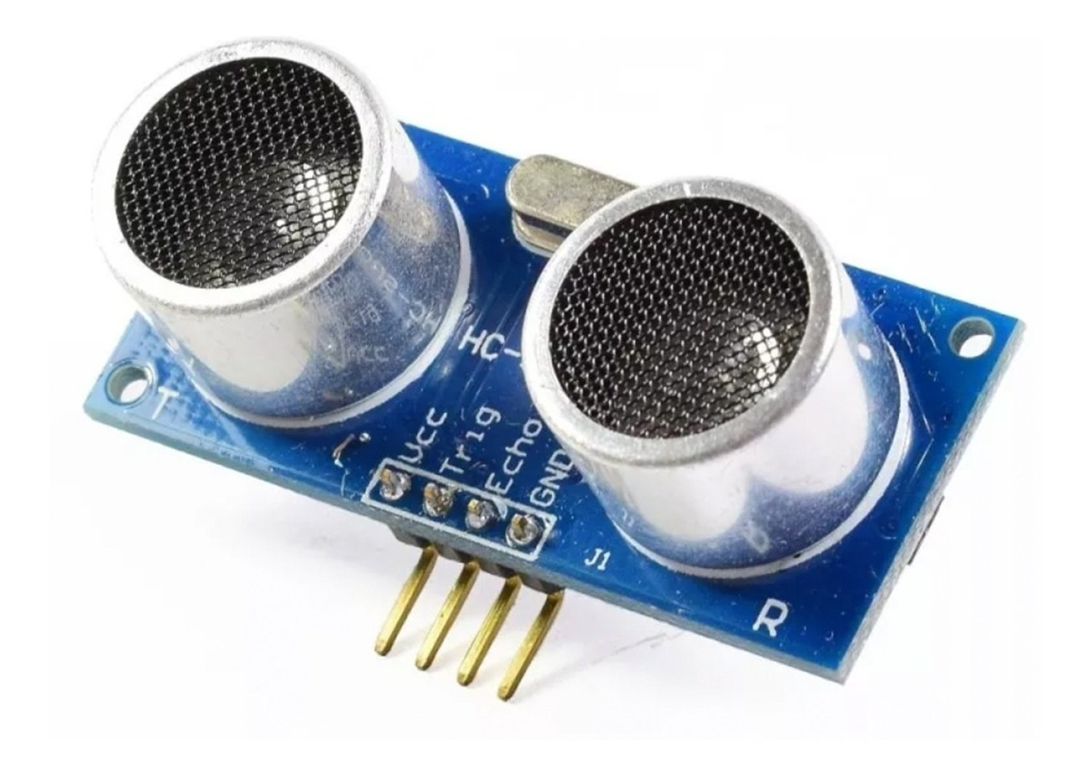
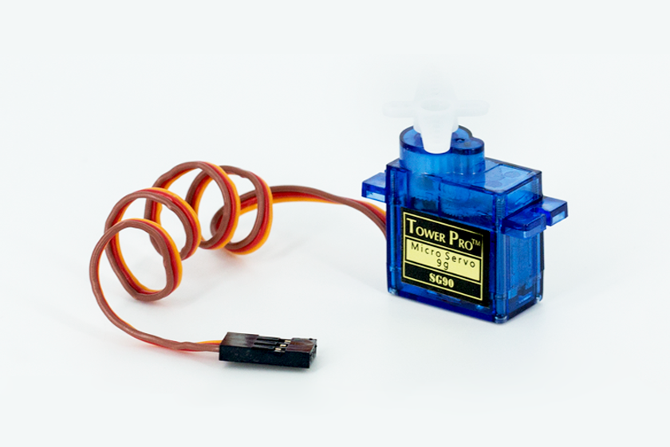
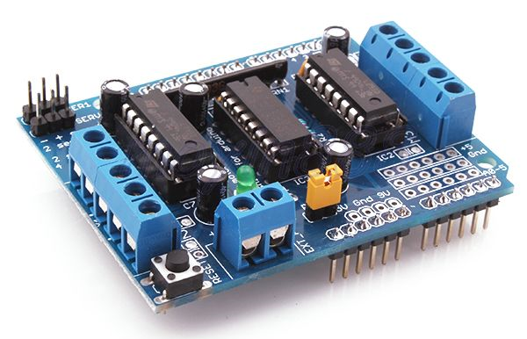
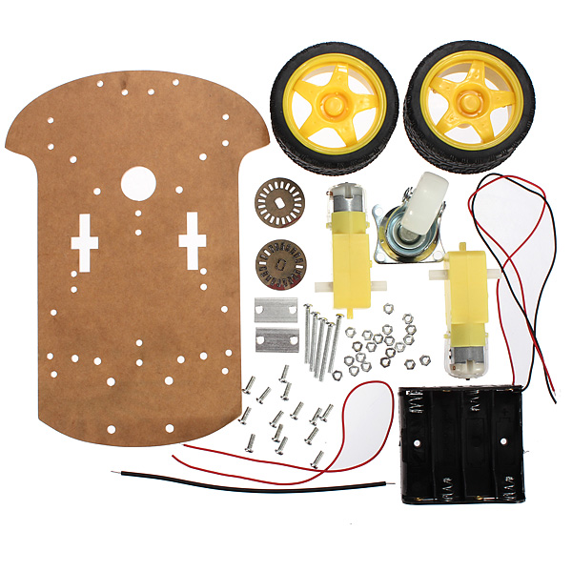

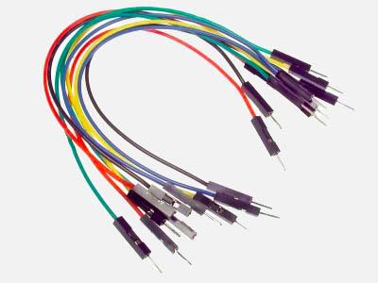
Components Used :
Arduino UNO with USB cable: Microcontroller for programming and controlling the robot.
Ultrasonic Sensor (SG90 HC-SR04): Detects obstacles and measures distance.
Servo Motor: Controls the robot's movement.
Motor Driver Shield for Arduino (L293D): Drives the motors.
Chassis kit: Physical structure of the robot.
Power Supply: Battery for powering the robot.
F-M jumper wires & connecting wires: For making connections, to
make a perfect circuit which is not broken.

Slide 6
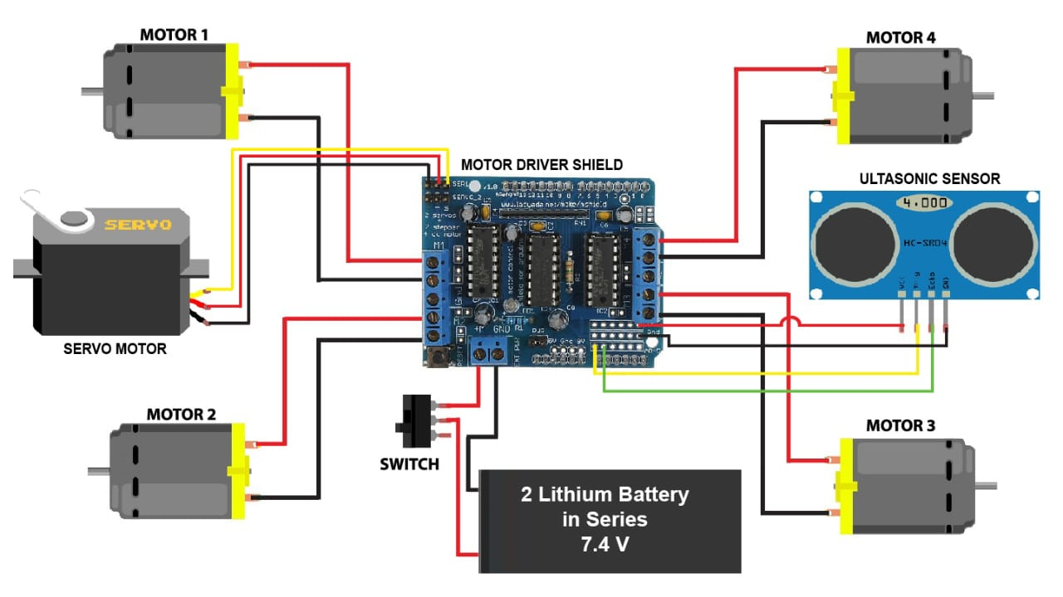
Circuit Diagram:

Slide 7
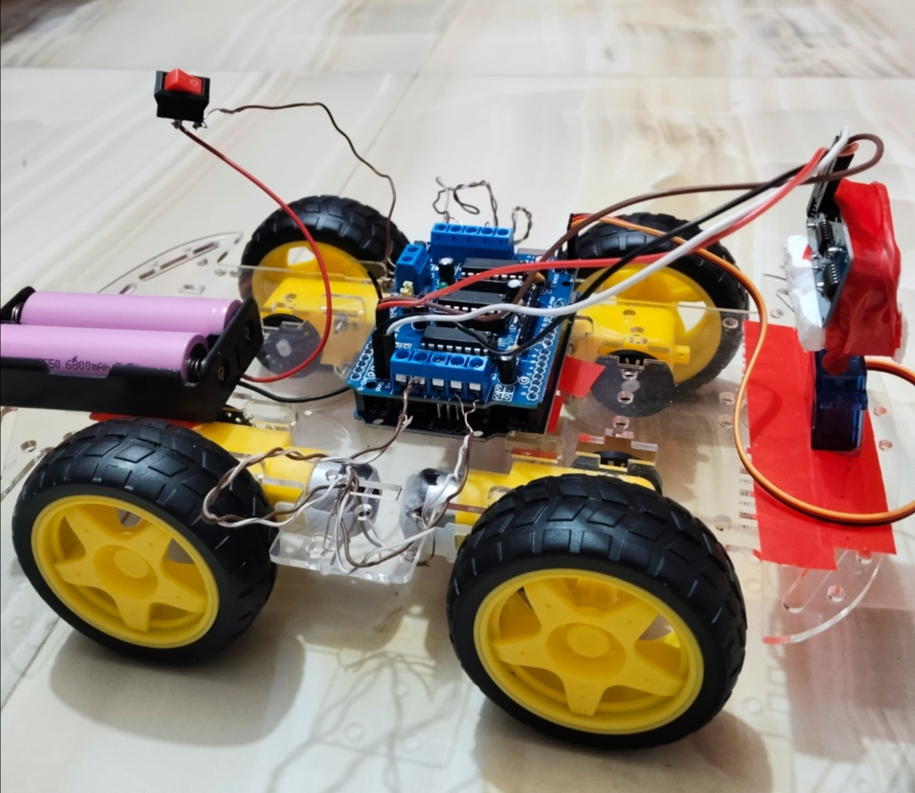
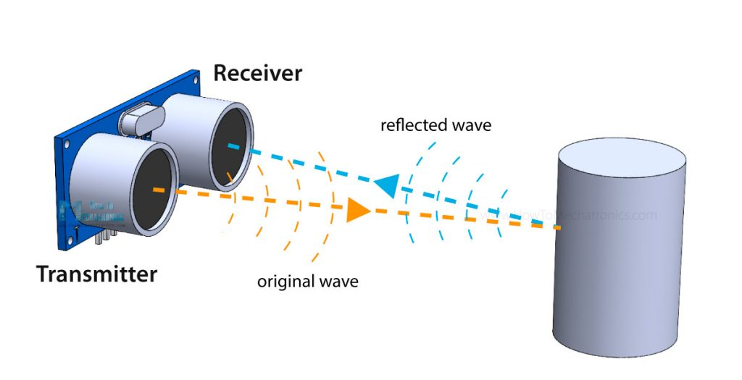
Working Principle:
The ultrasonic sensor emits sound waves to detect obstacles. When an obstacle is detected within a predefined range, the Arduino processes the information and directs the robot to stop, turn, or move in a different direction to avoid collision.

Slide 8
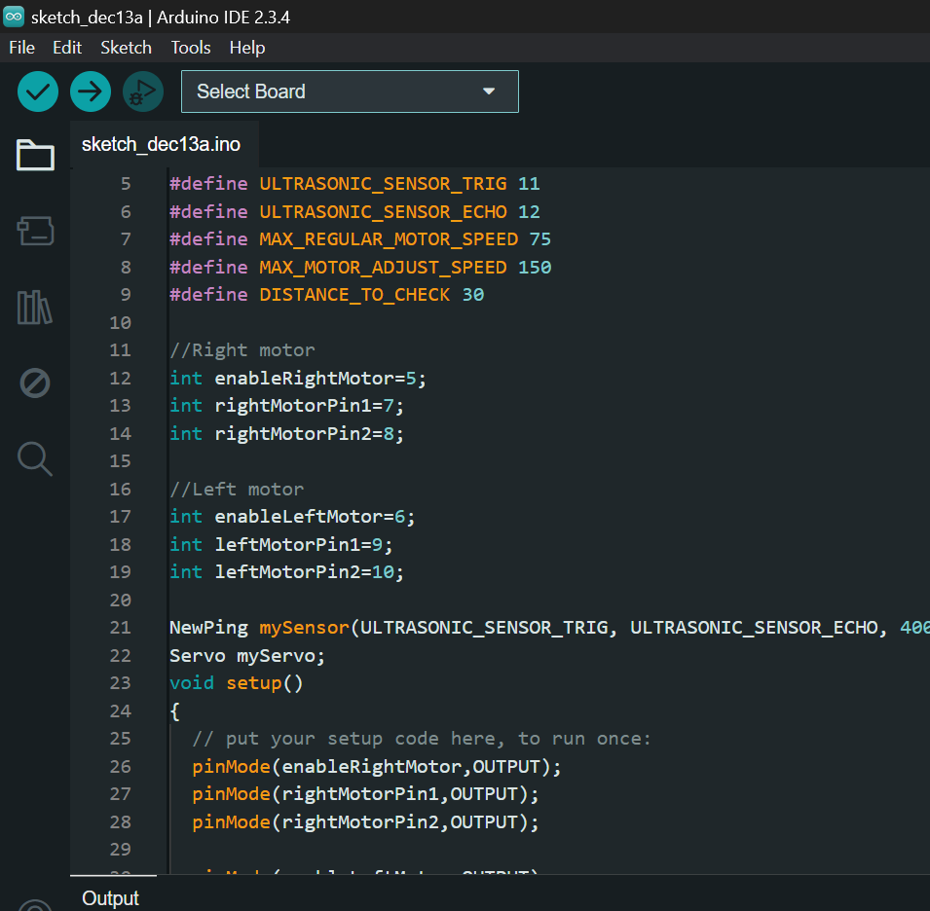
Hardware and Software Implementation:
1.Hardware Details:
Assembly of the chassis and motors.
Integration of the Arduino and sensors.
Connecting the motor driver for movement control.
2.Software Details:
Programming the Arduino using the Arduino IDE.
Algorithm for obstacle detection and avoidance.
Calibration of sensor thresholds for accuracy.

Slide 9
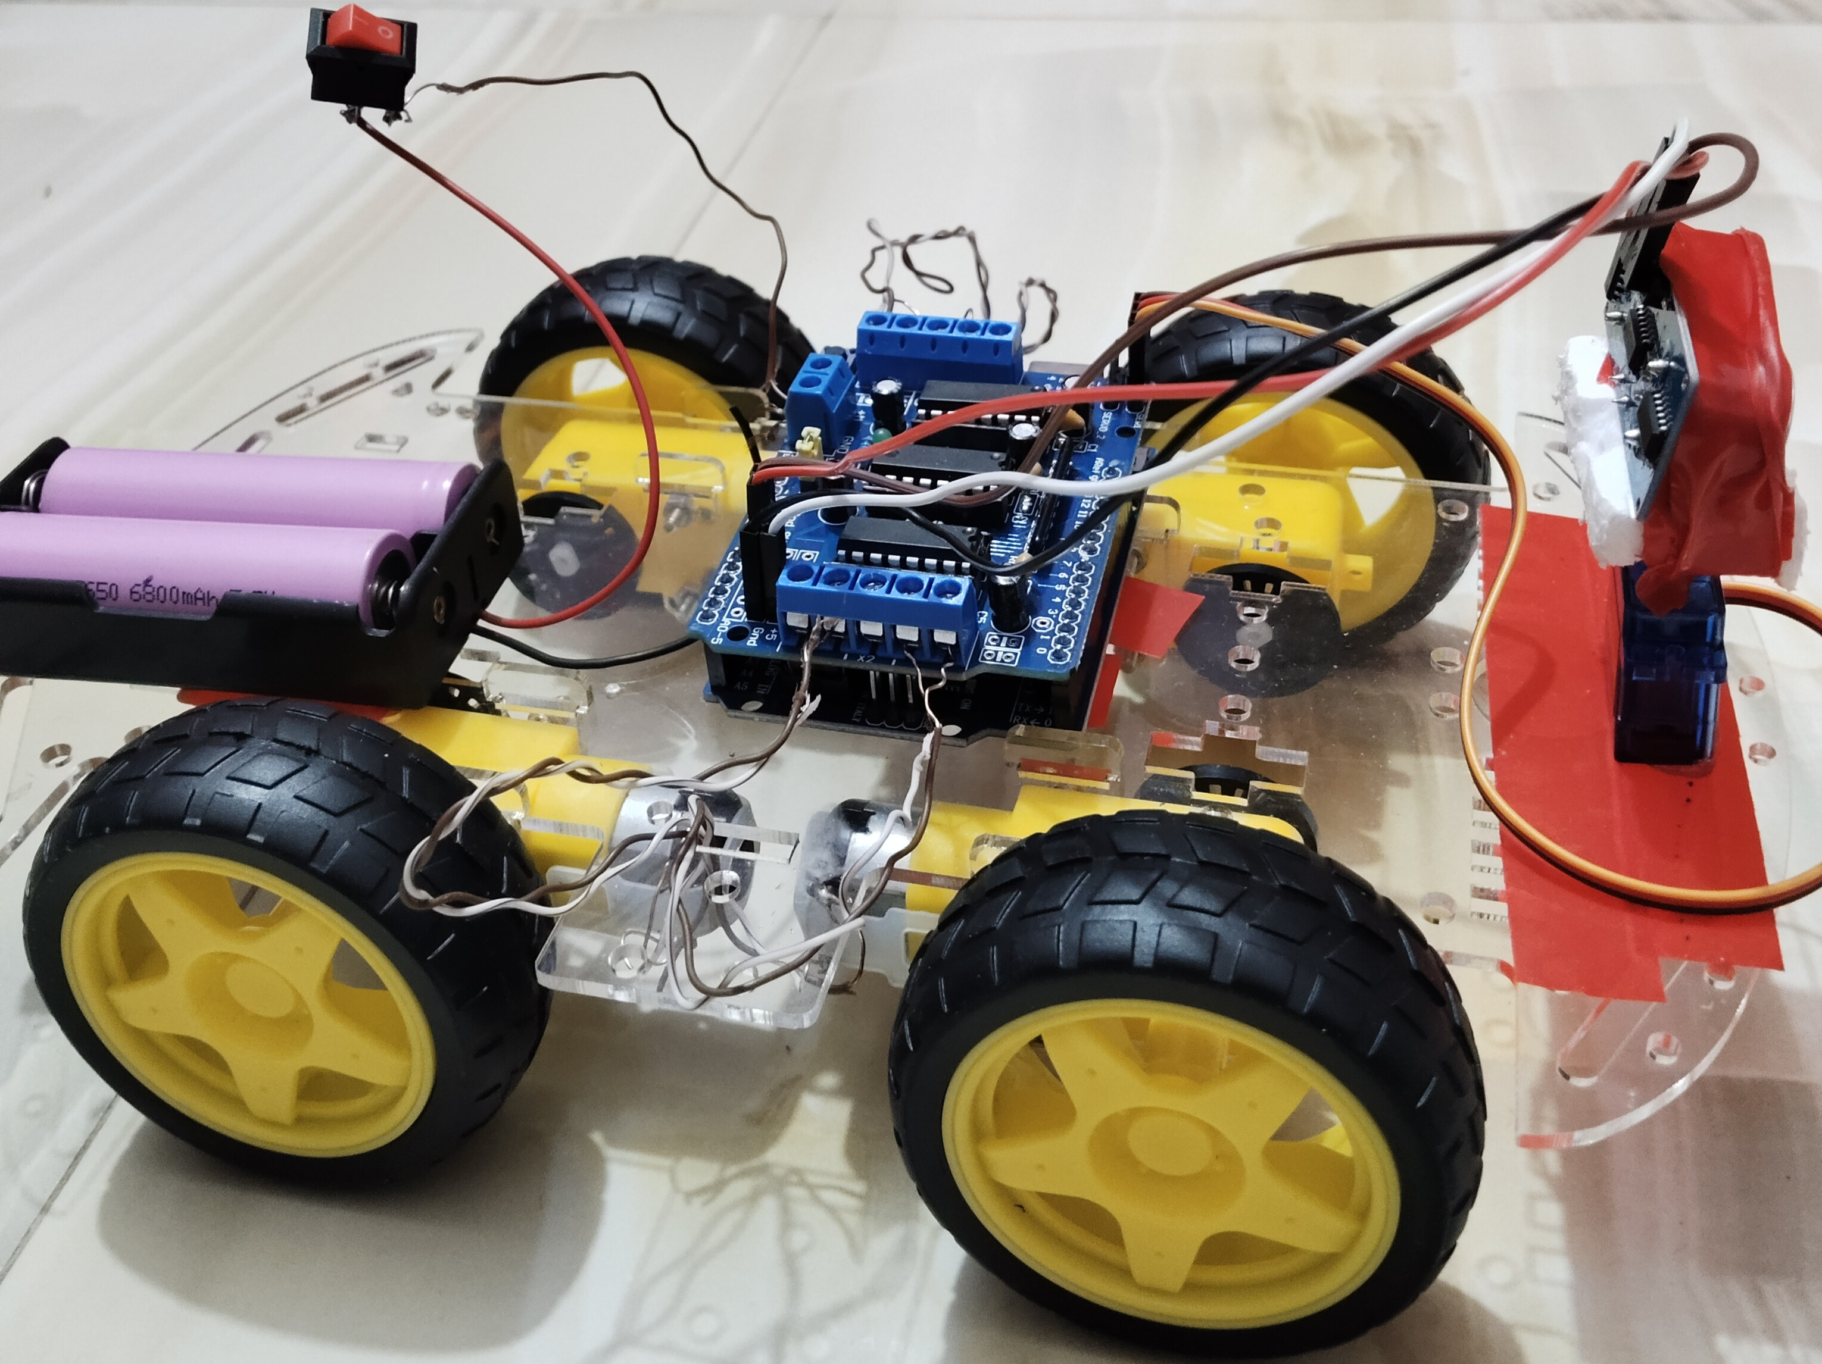
Challenges and Solutions:
Sensor Misalignment: Our sensor moved inaccurately during operation. Solution: Secured it firmly.
IDE issue: We could not download the extension initially. Solution: Installed it manually.
Motor Synchronization: Motors move at uneven speed. Solution: Adjust motor speed through PWM signals for smoother movement.
Connection problem: Motor didn’t move due to loose wires. Solution: Tightened connections.

Slide 10
Applications:
Almost all mobile robot navigation systems can make use of obstacle-avoiding robots.
They can be employed for domestic chores like automatic vacuuming.
They can be employed in hazardous conditions where human penetration might be lethal.
Conclusion:
This project successfully demonstrates an obstacle-avoiding robot using Arduino. The integration of sensors and software enables the robot to navigate autonomously, showcasing a practical application of robotics in real-world scenarios.

Slide 11
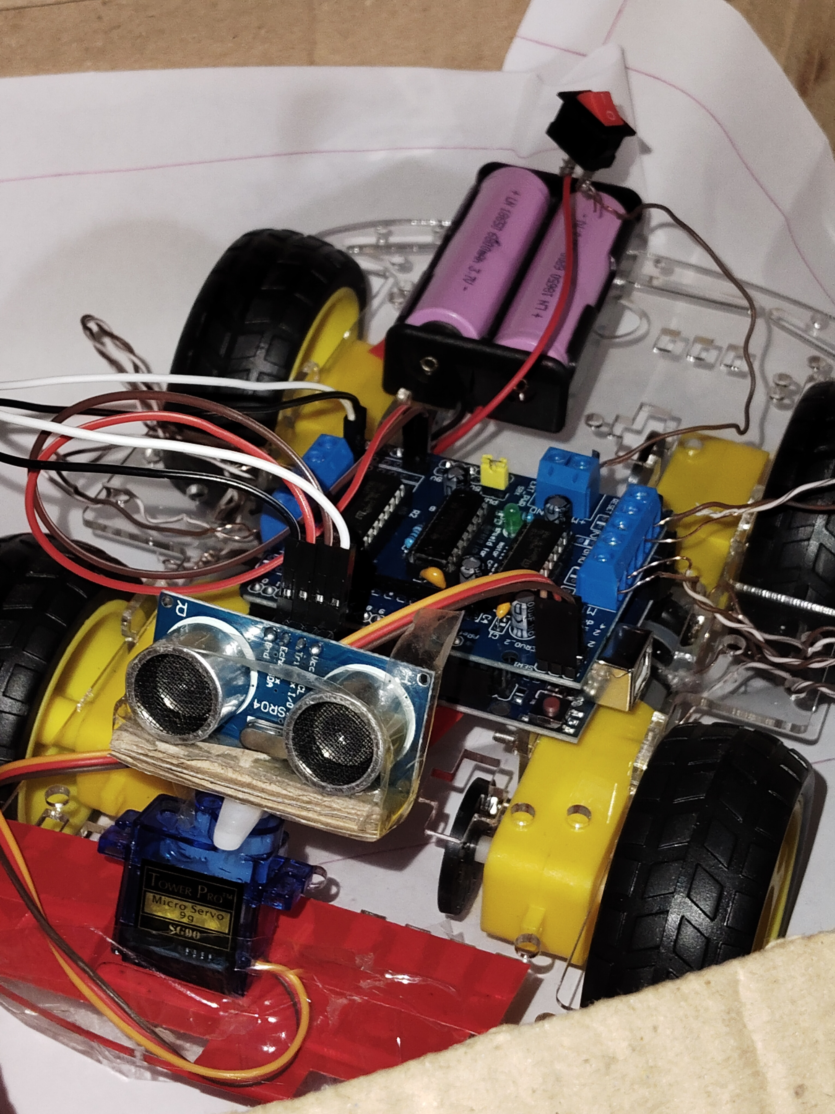


Slide 12


